Slide 1
XR Platforms
Immersive Technology
(VR, AR, MR) will have a
huge impact on our lives.
Mohamed Galal

Slide 2
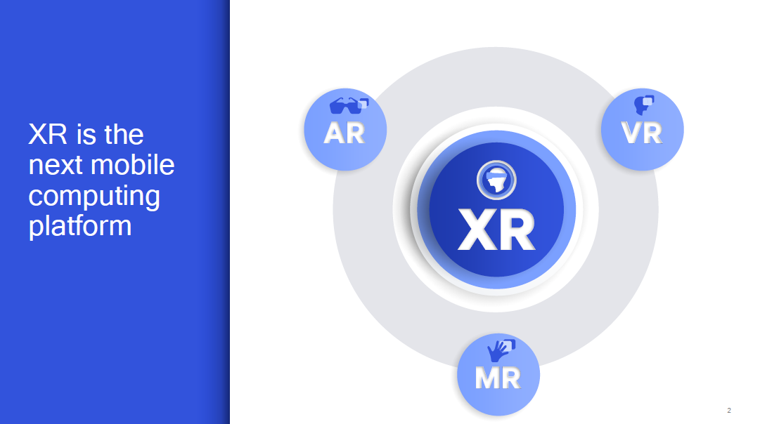

Slide 3
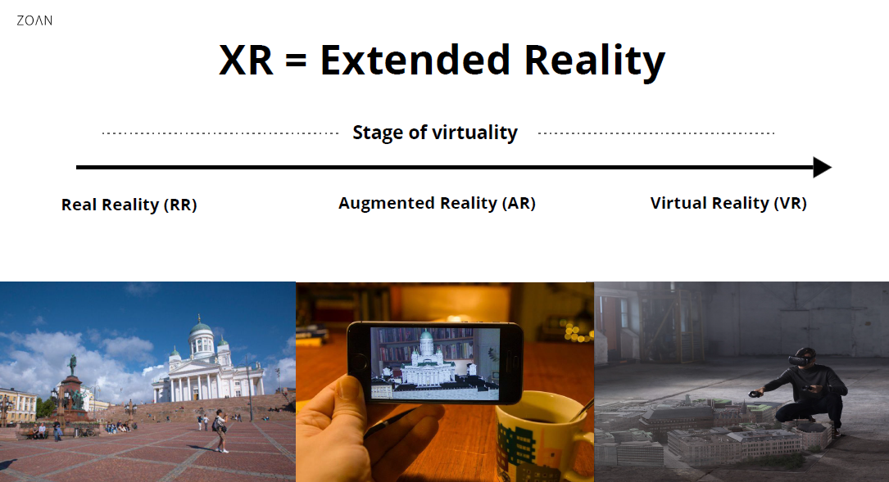

Slide 4
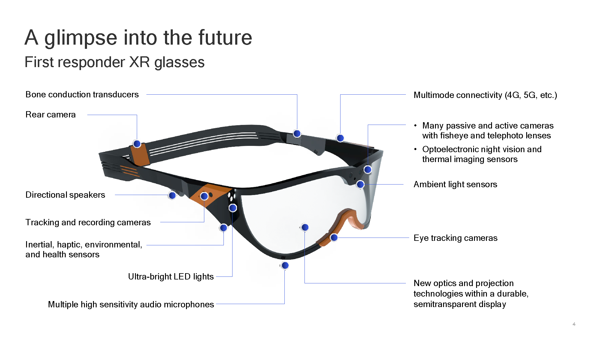

Slide 5
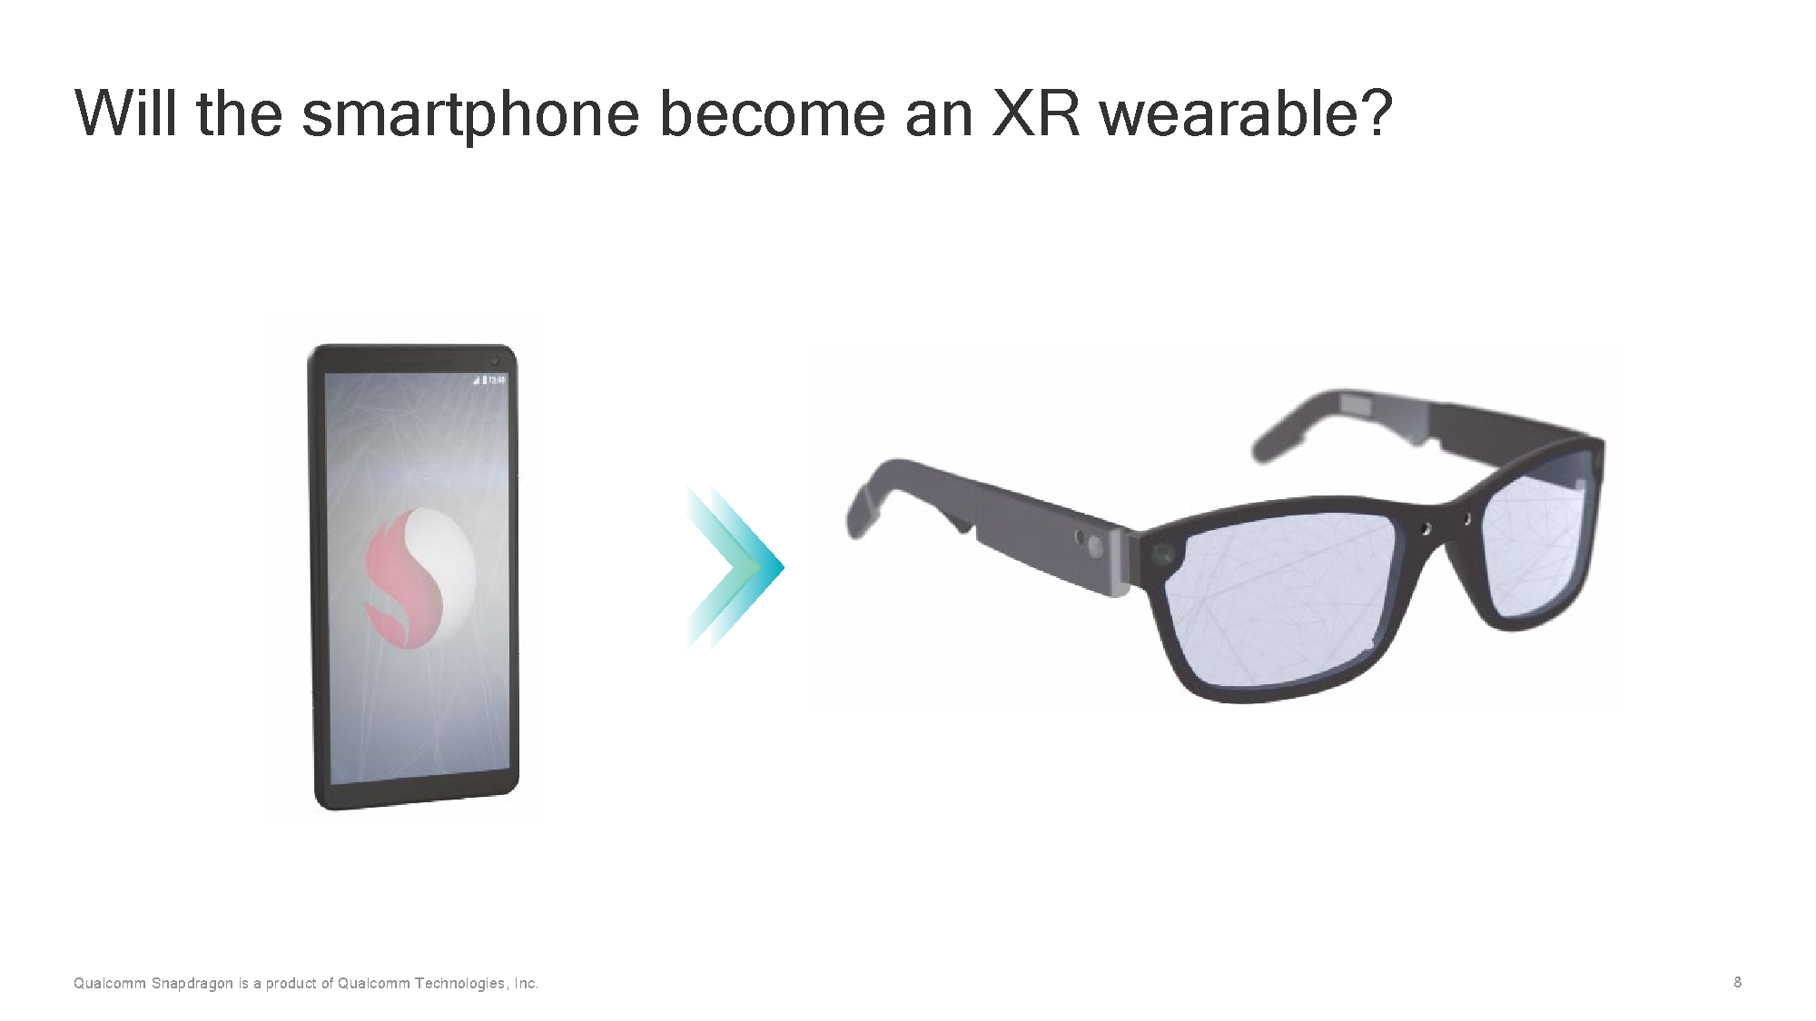

Slide 6
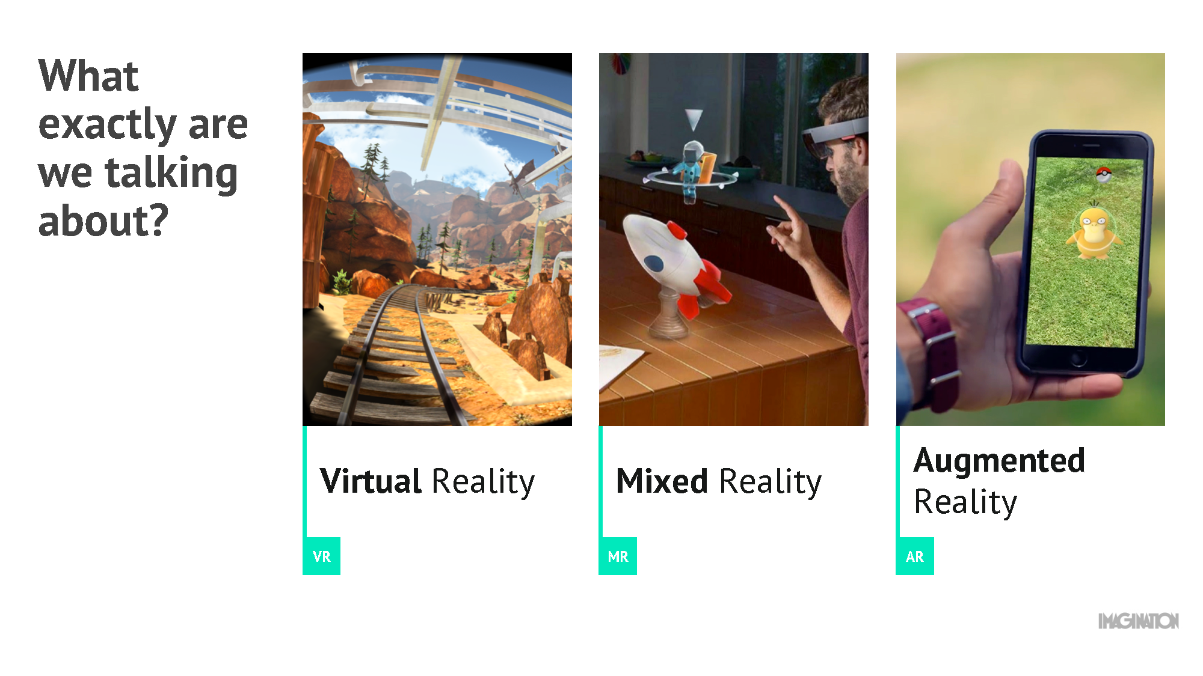

Slide 7
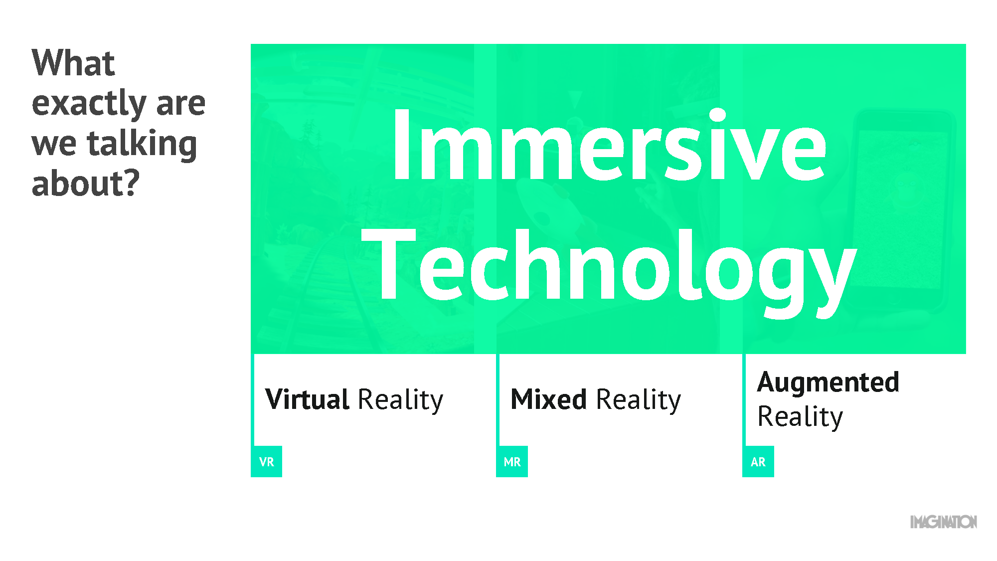

Slide 8
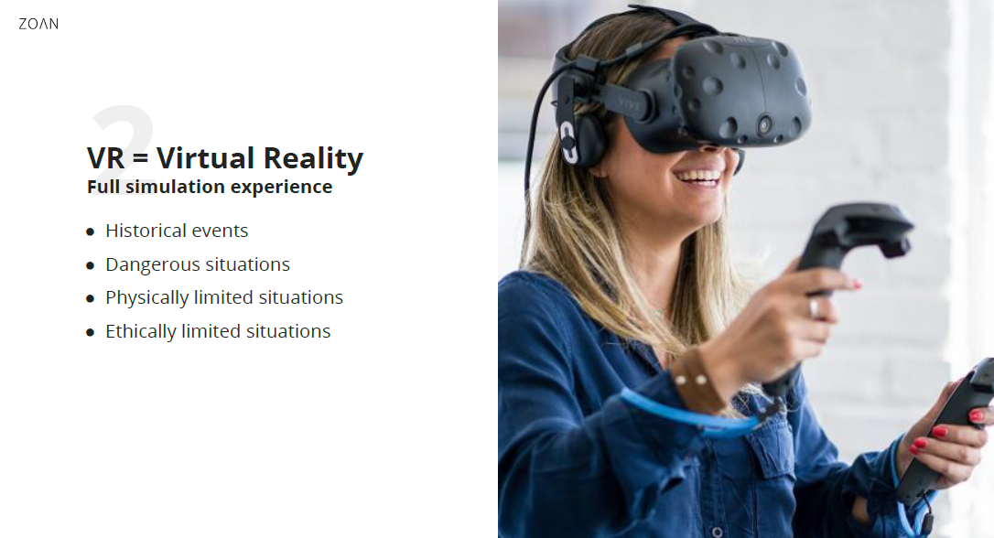

Slide 9
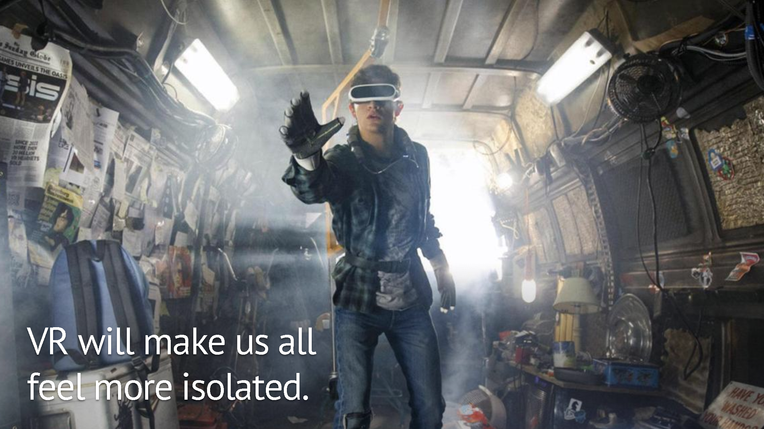

Slide 10
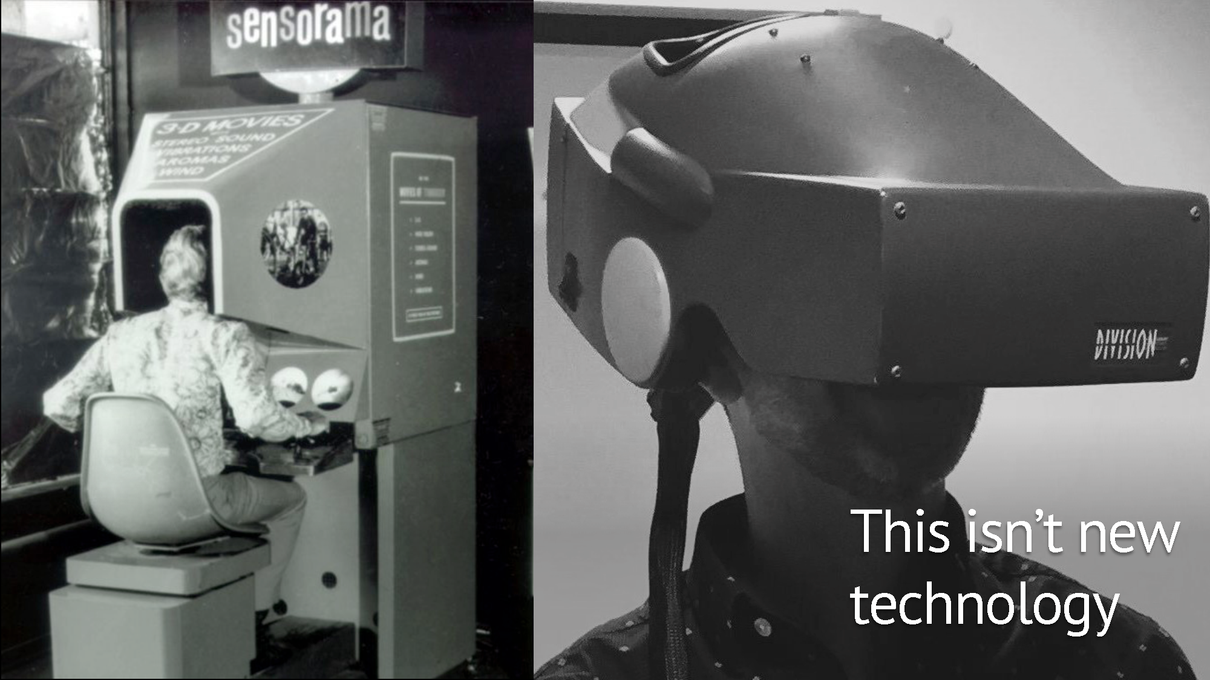

Slide 11
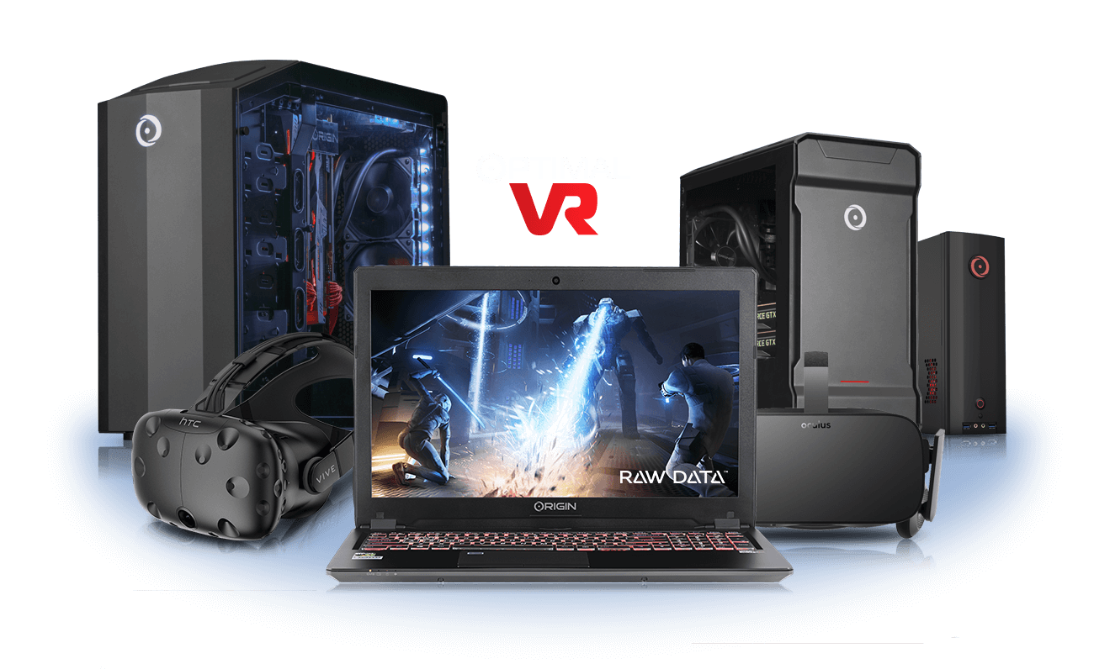
Hardware Devices
Input Device
Output Device

Slide 12
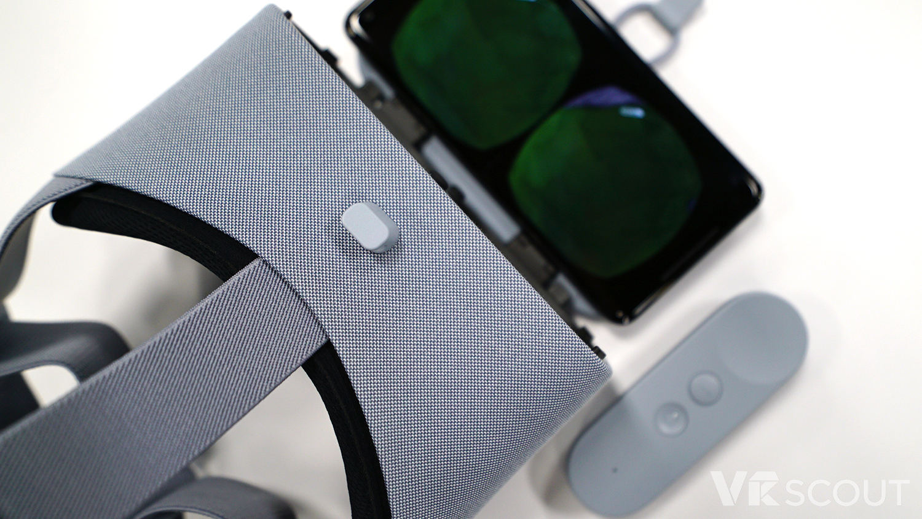
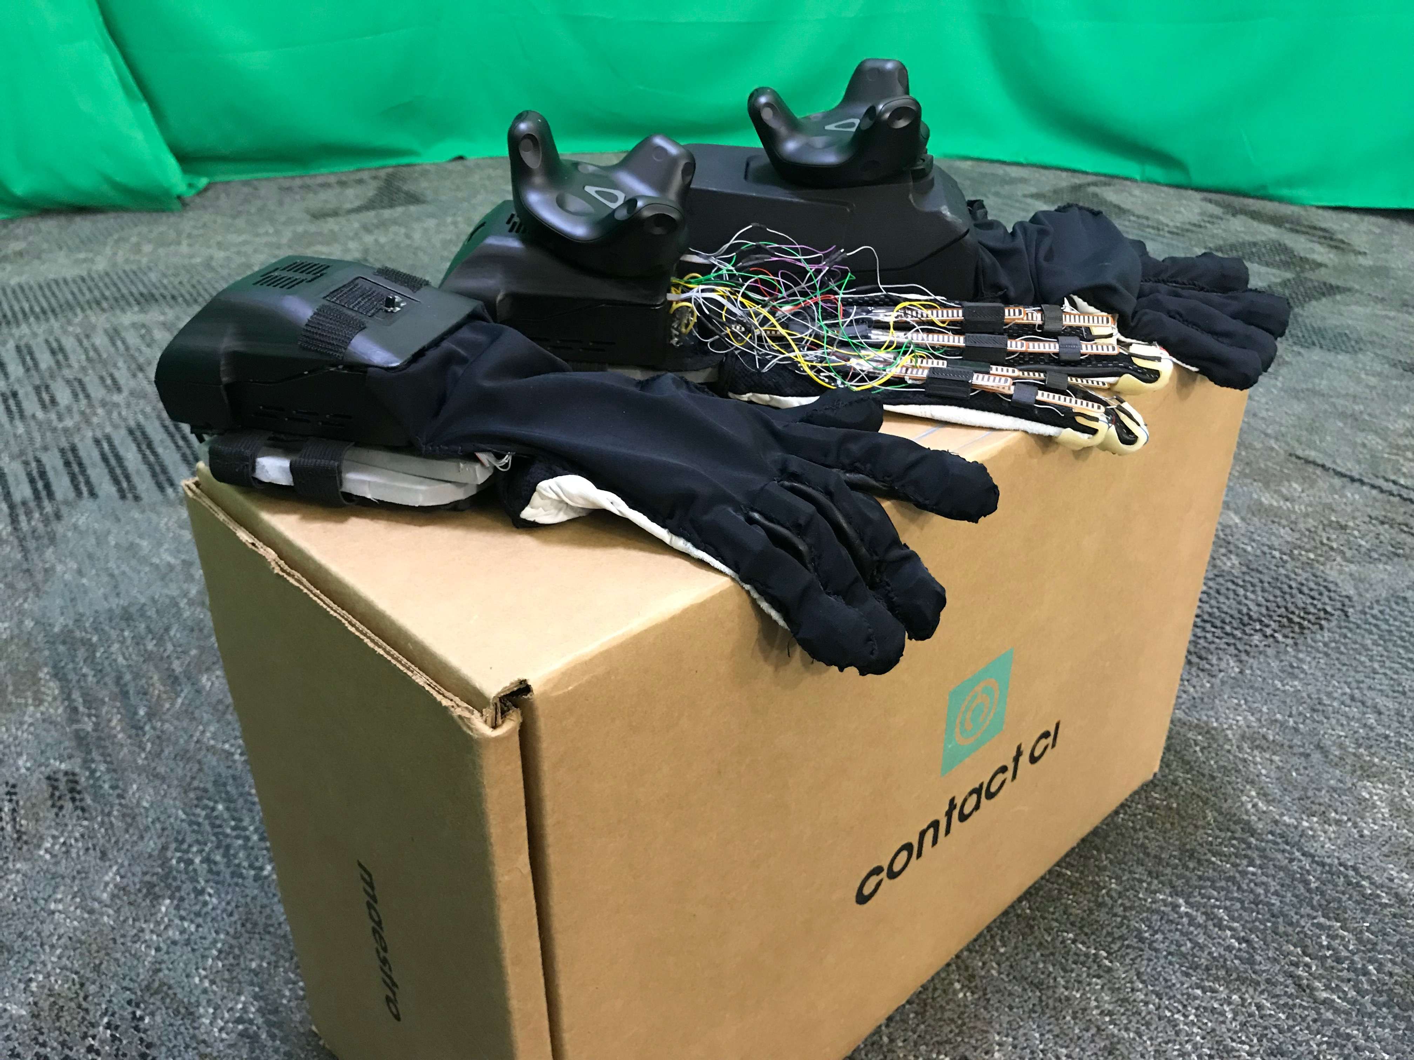
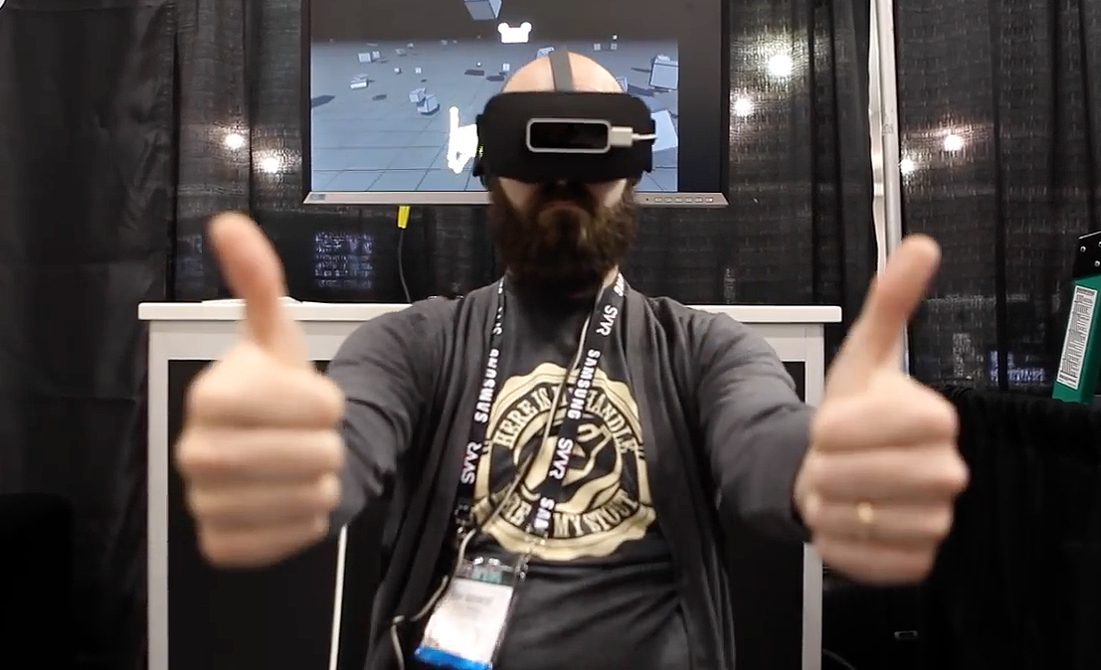
Input Device
3DOF Wand Controllers
Wearable
Leap Motion

Slide 13
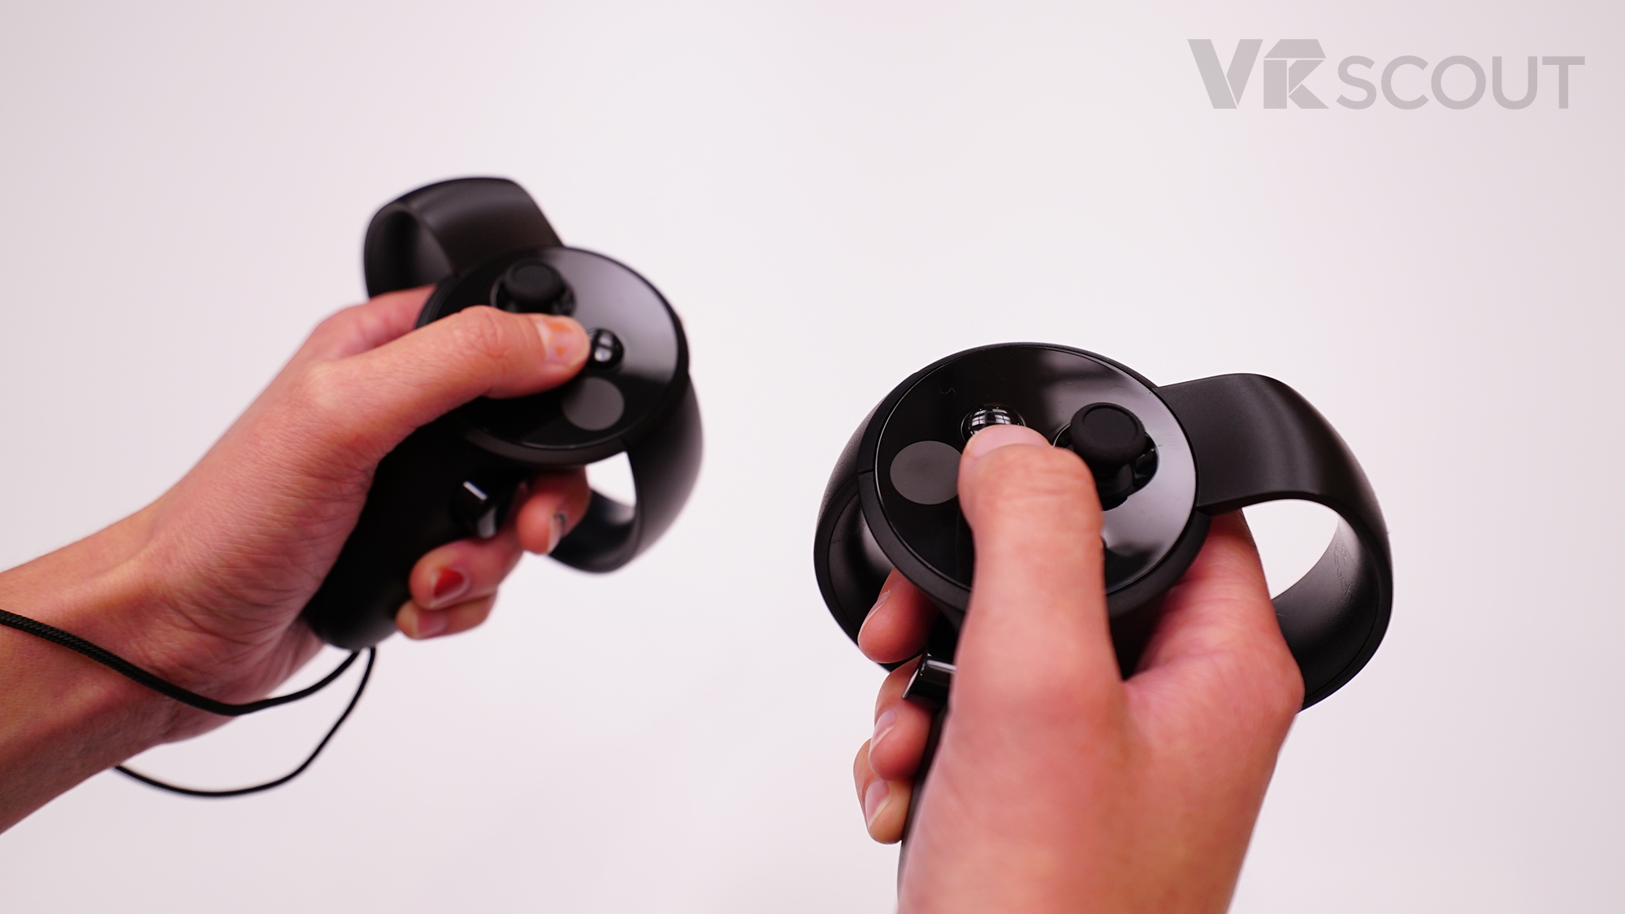
Input Device
.
6DOF Wand Controllers

Slide 14
Output Device
.
.
Headset
3d Audio

Slide 15
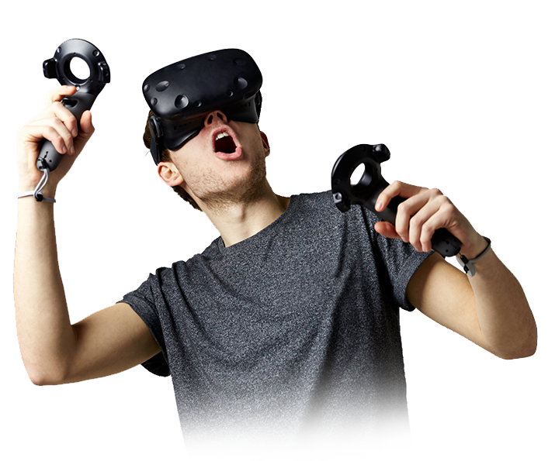
Headsets
https://www.pcmag.com/picks/the-best-vr-headsets
https://www.techradar.com/news/the-best-vr-headset

Slide 16
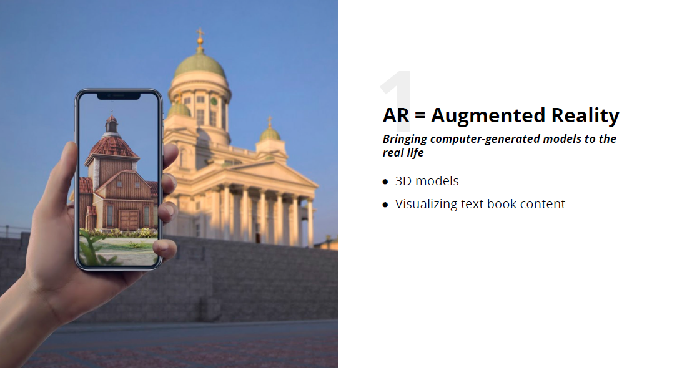

Slide 17
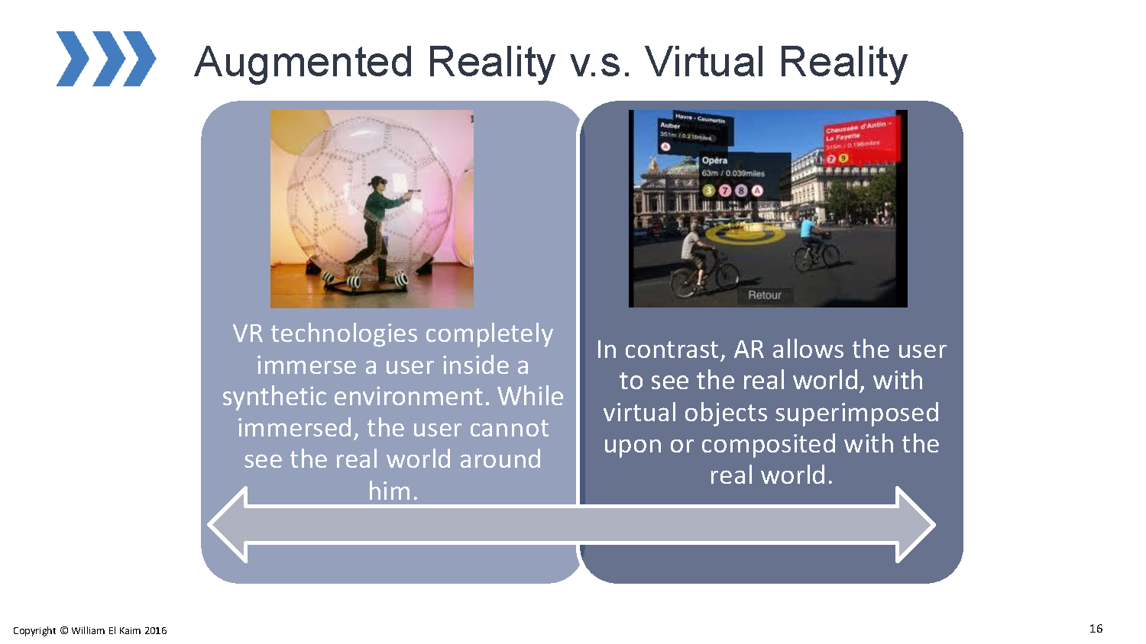

Slide 18
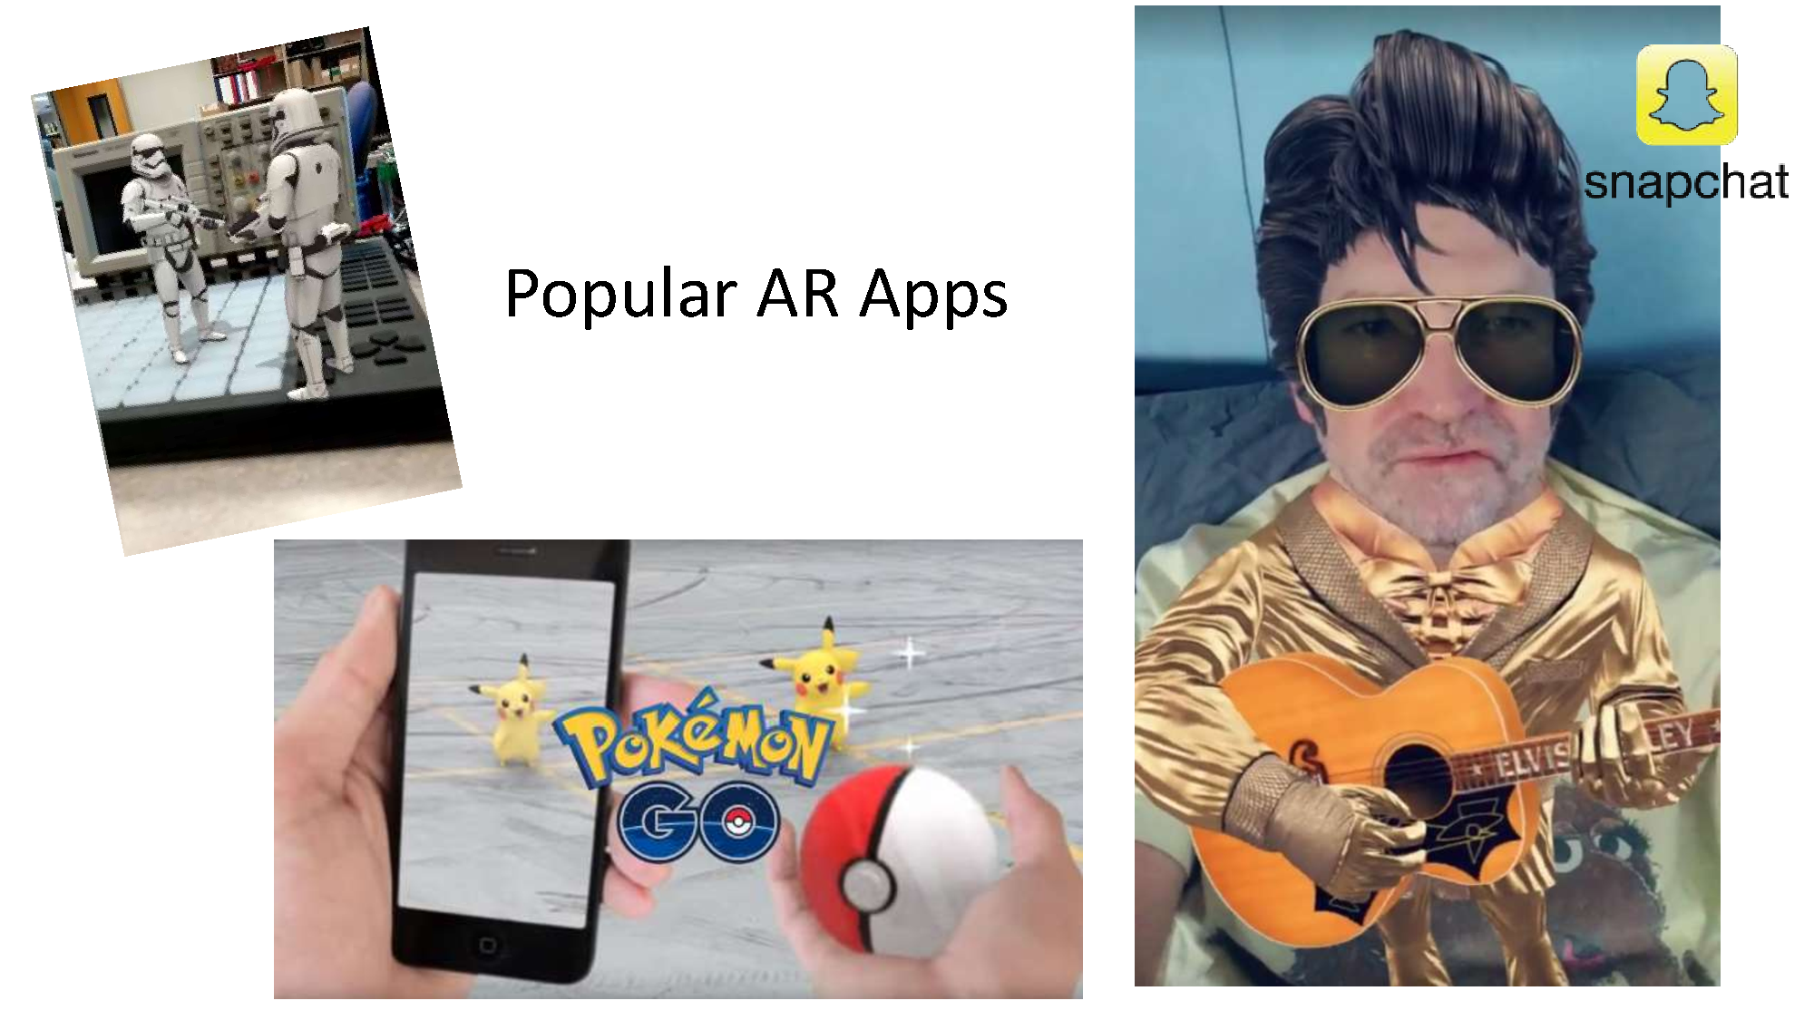

Slide 19
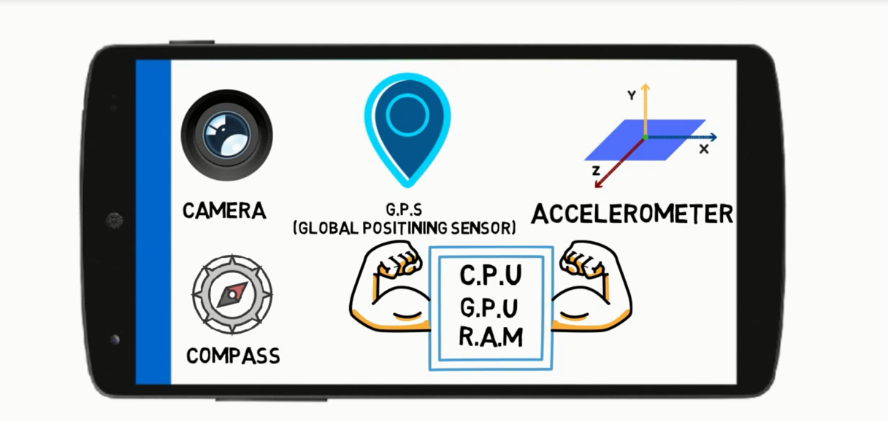

Slide 20
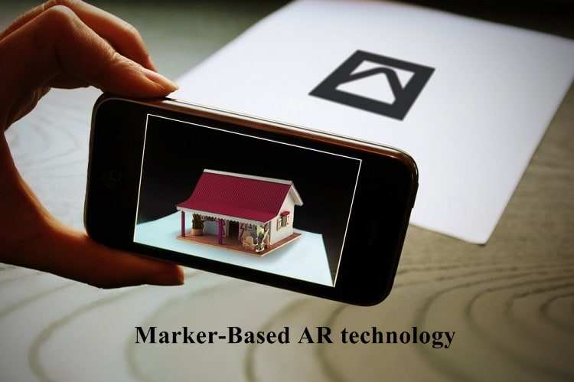
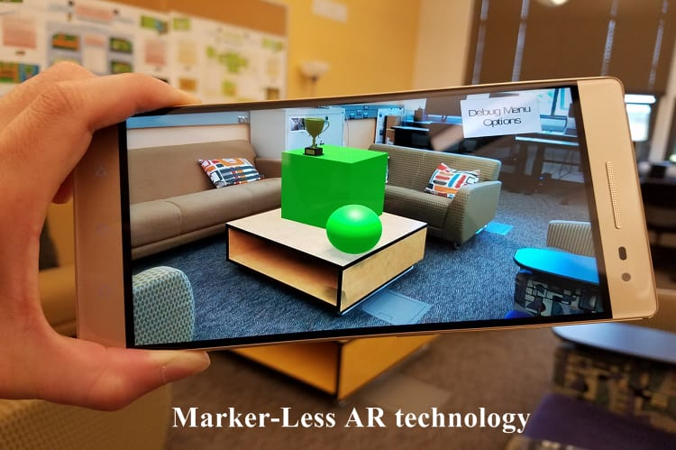
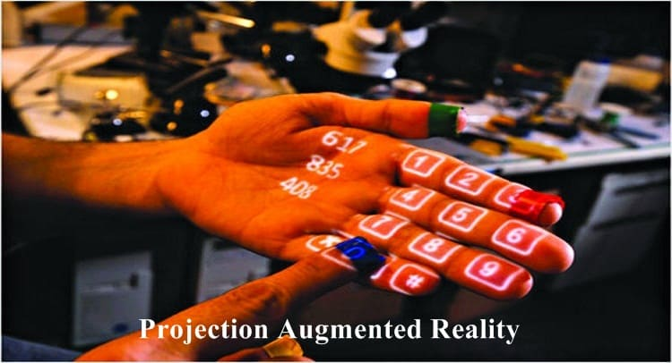
Augmented Reality types
Marker-Based Augmented Reality
Location Based (Markerless)
Projection Augmented Reality

Slide 21
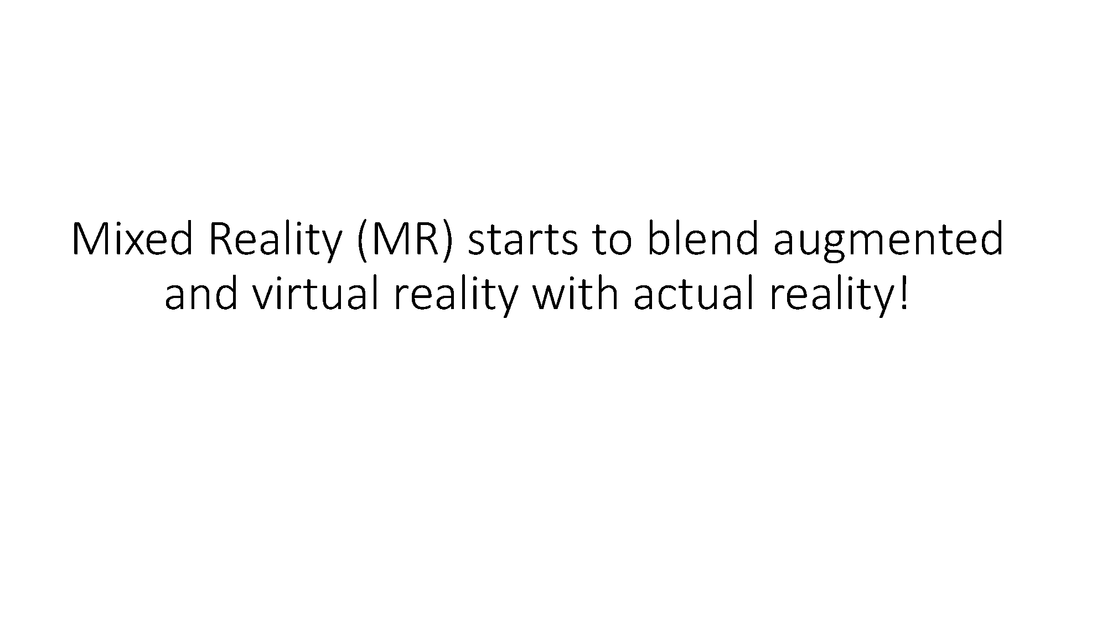

Slide 22
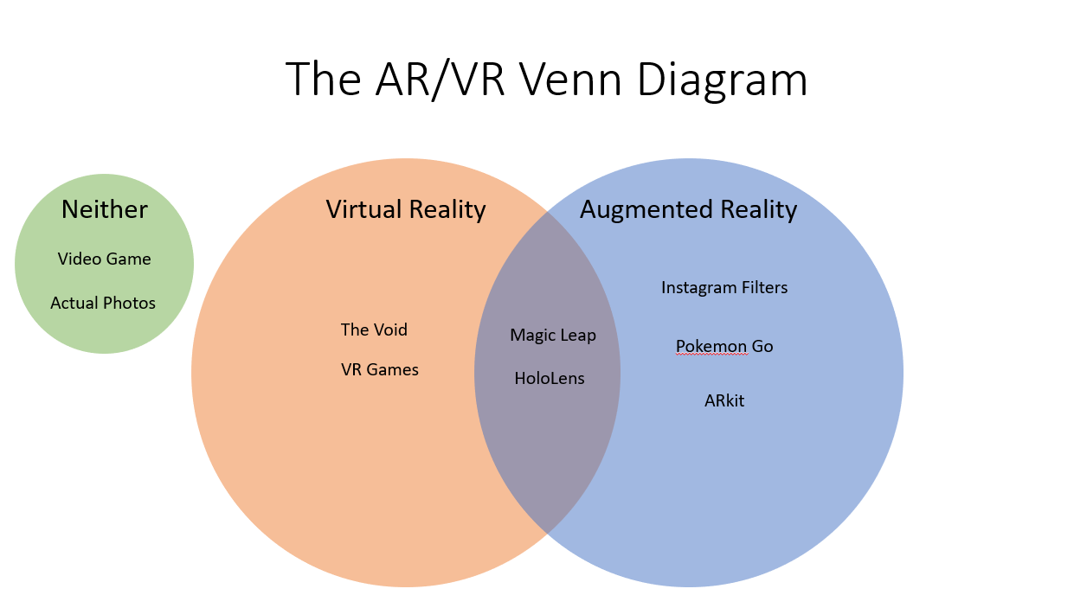

Slide 23
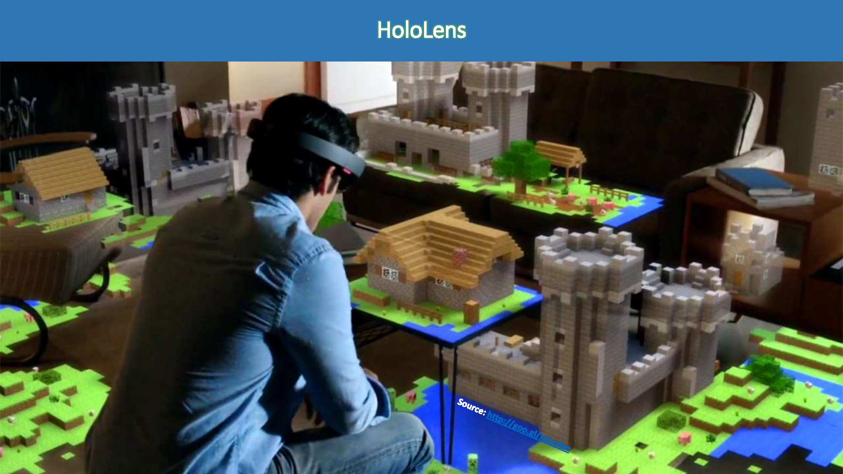

Slide 24


Slide 25


Slide 26
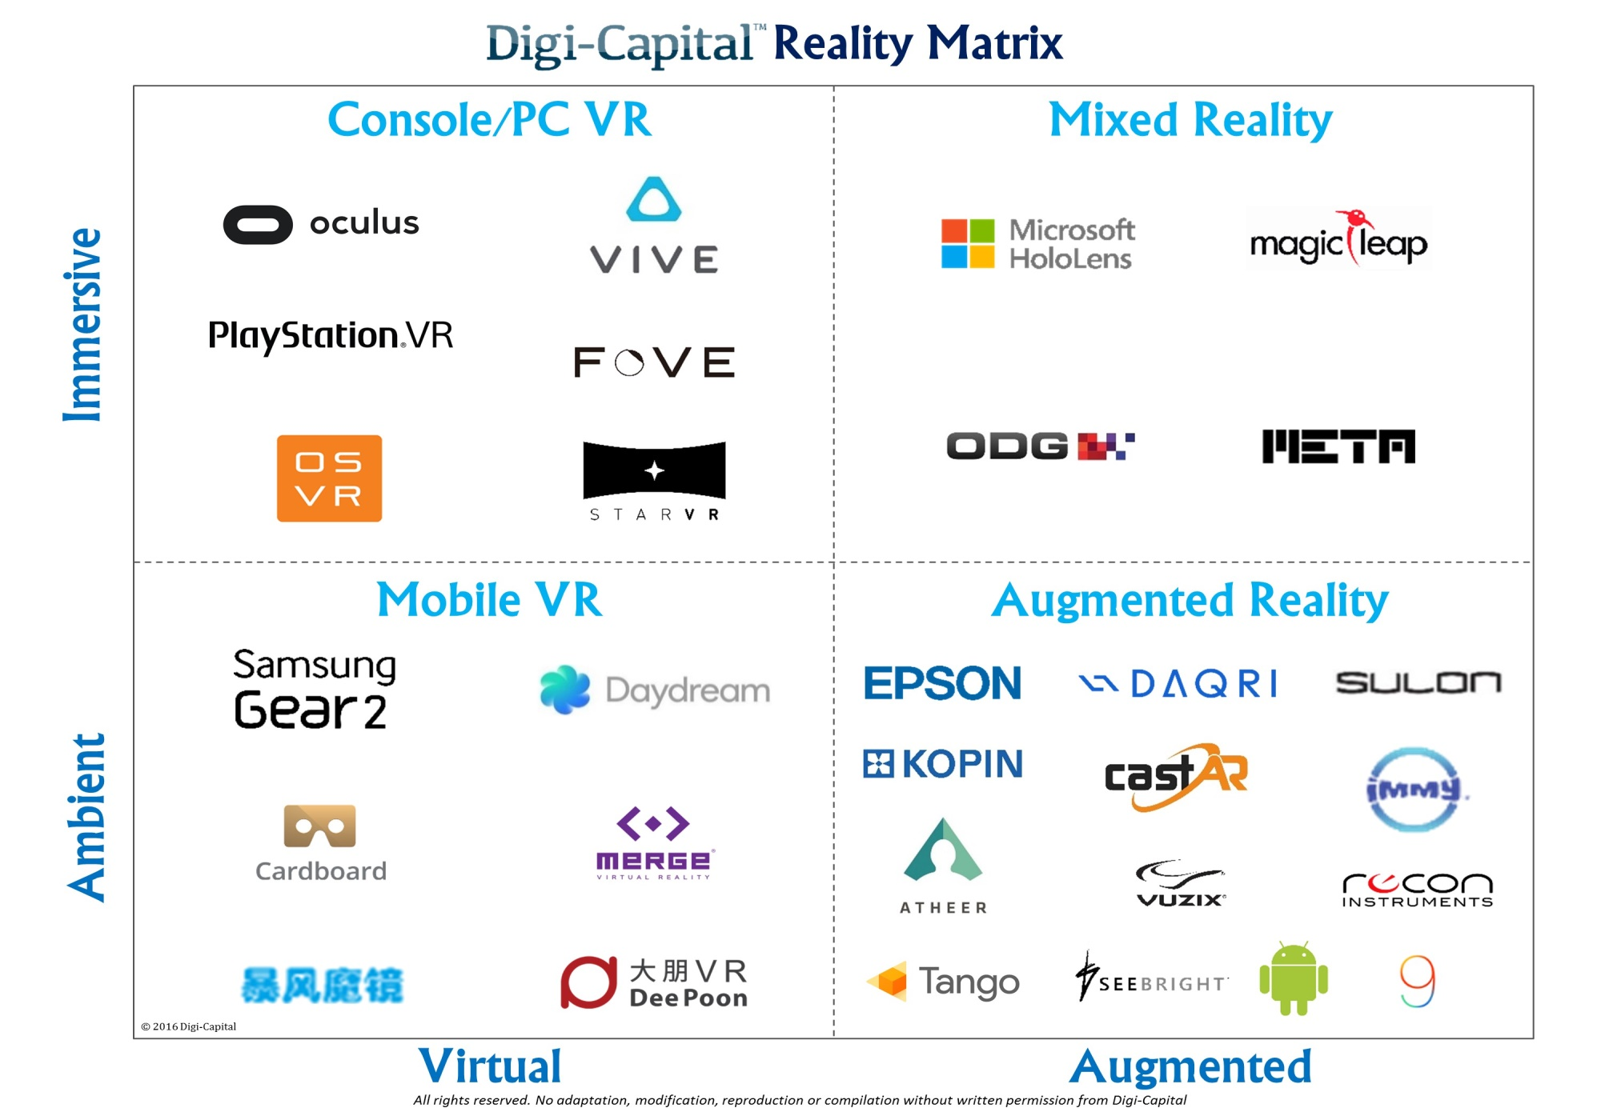

Slide 27
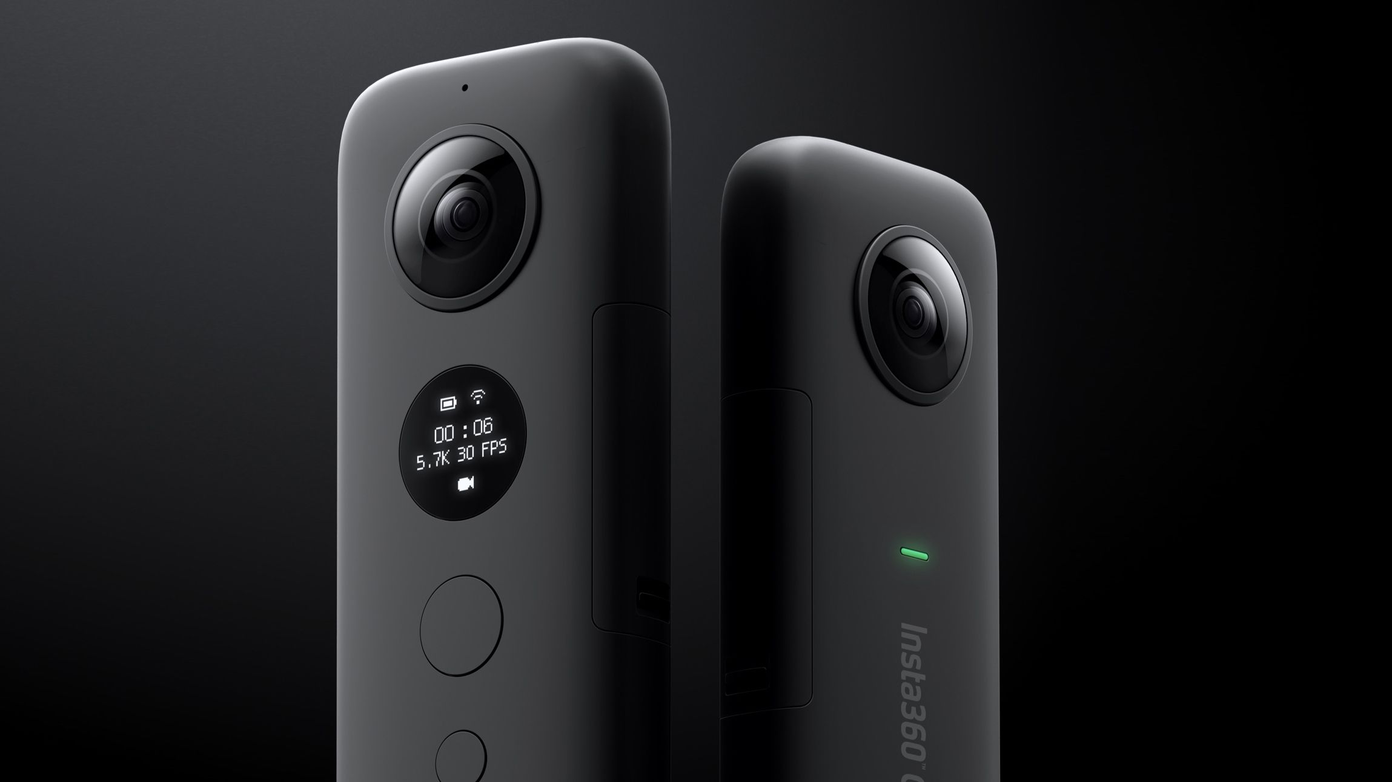

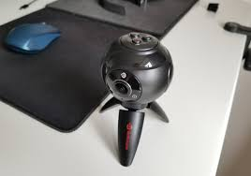
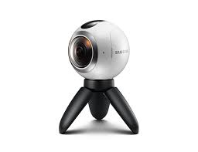
360

Slide 28
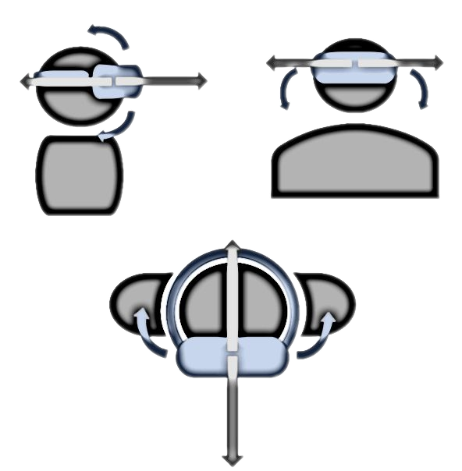
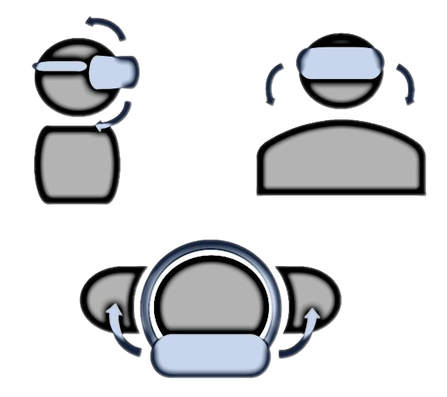
3DOF - 6DOF

Slide 29
Egyptian Industry
Grean
gensis
spinzomedia
Medgram
5d-vr
vrapeutic
VRTeek
412Labs
Hordecore
VREgypt
Youmaku Games
2024 studios
AN Games
Appsinnovate
Funwave Games
Gimzat
Instinct Games
Insya
Masked Pharaohs
Qamar Games
Rumbling Games
cryptyd

Slide 30
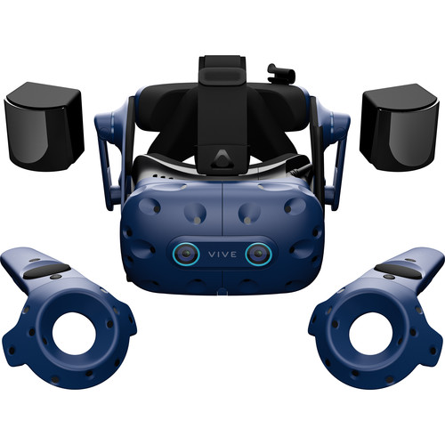
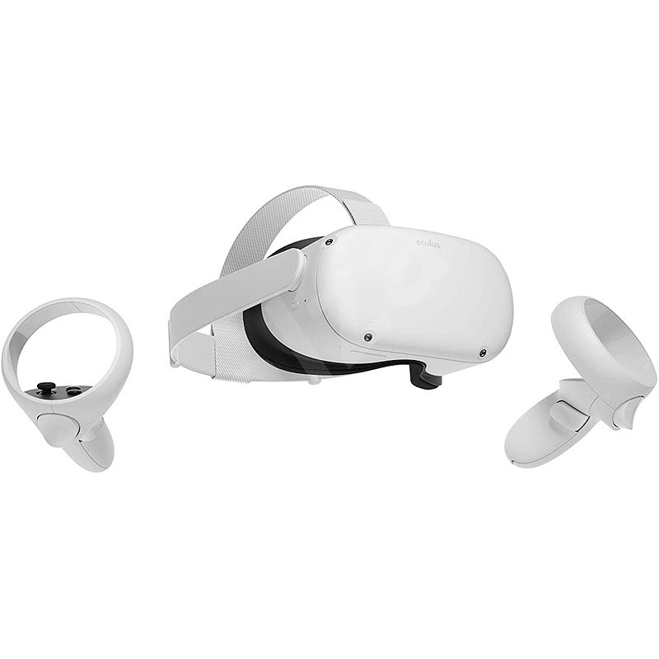
DESKTOP-MOBILE (CONTROLLER- MOVEMENT)
https://www.visartech.com/blog/advantages-of-standalone-vr-over-pc-vr/

Slide 31
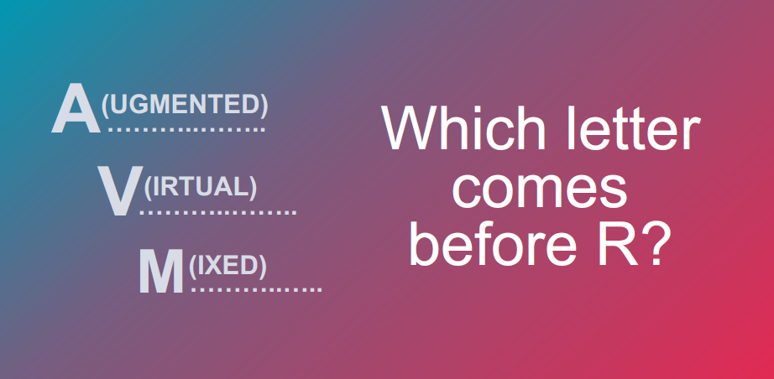

Slide 32
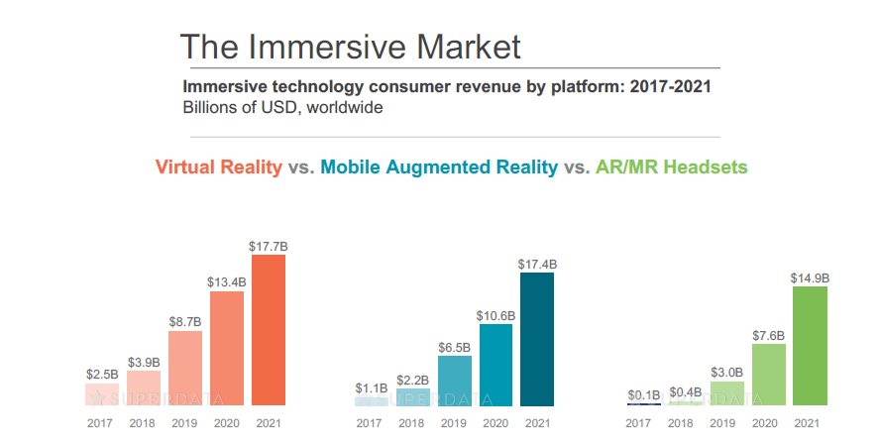

Slide 33
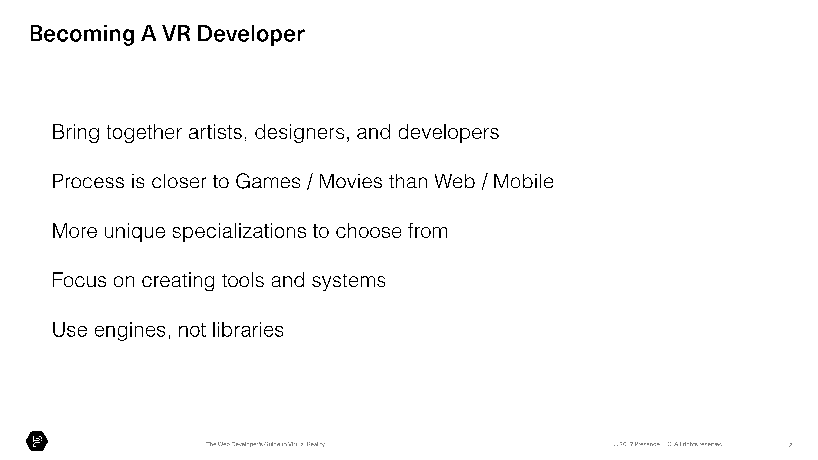

Slide 34


Slide 35


Slide 36
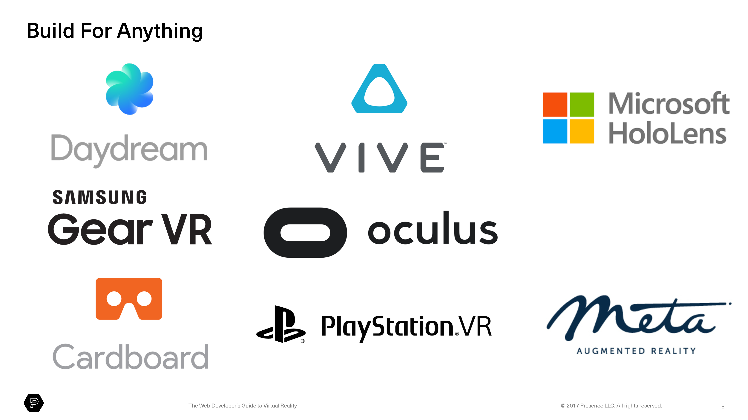

Slide 37
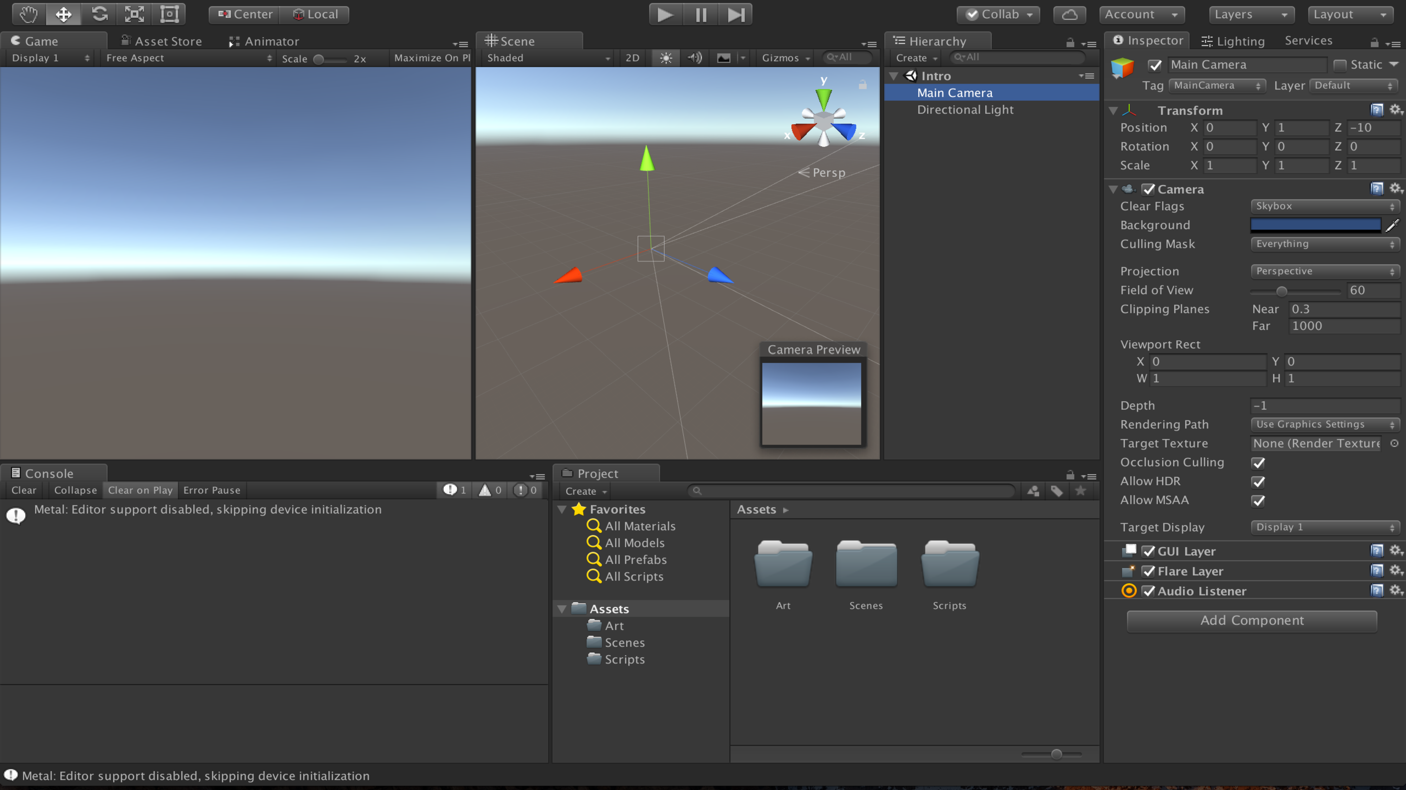

Slide 38


Slide 39
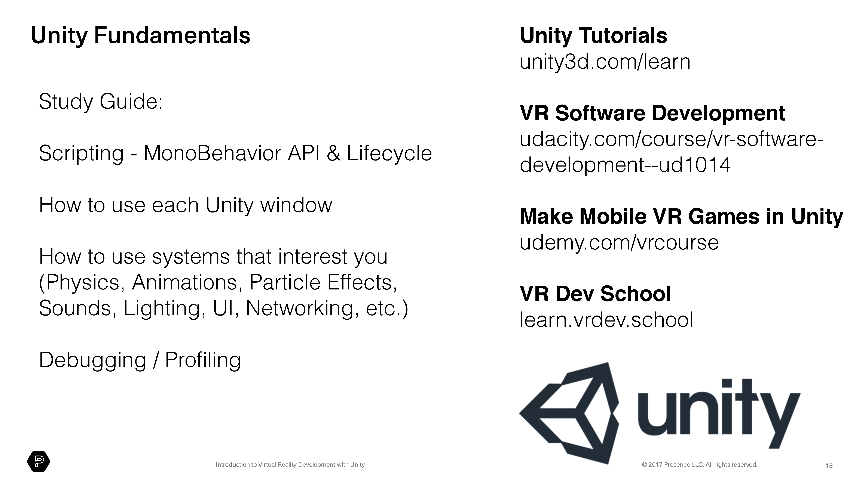

Slide 40


Slide 41
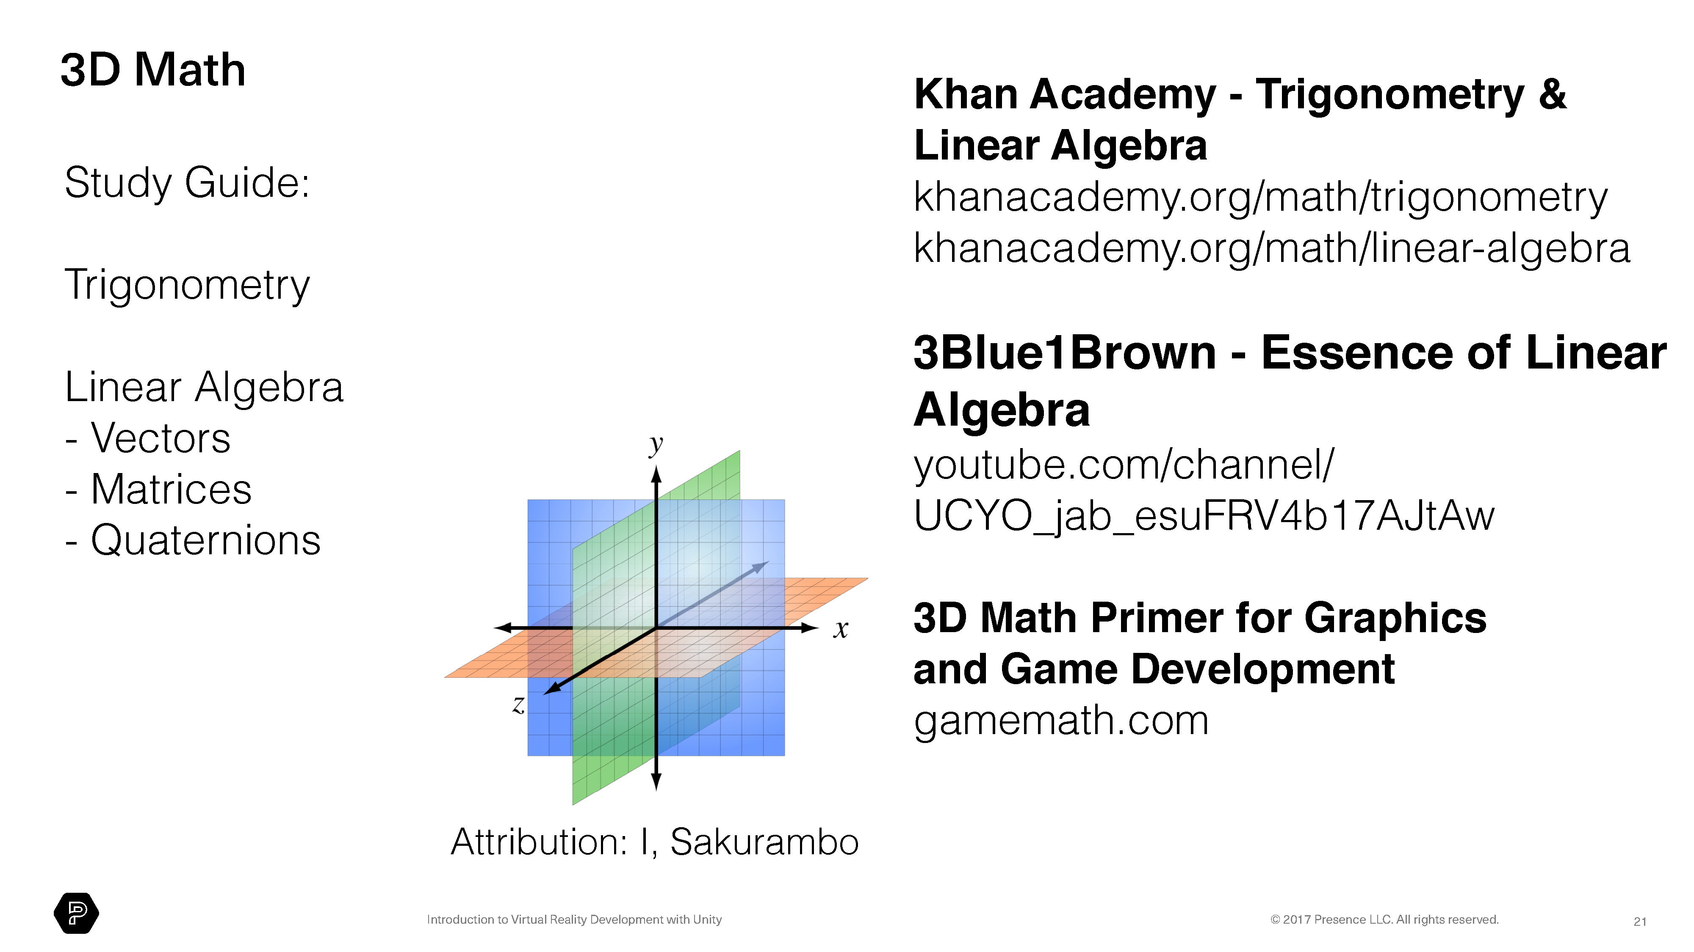

Slide 42
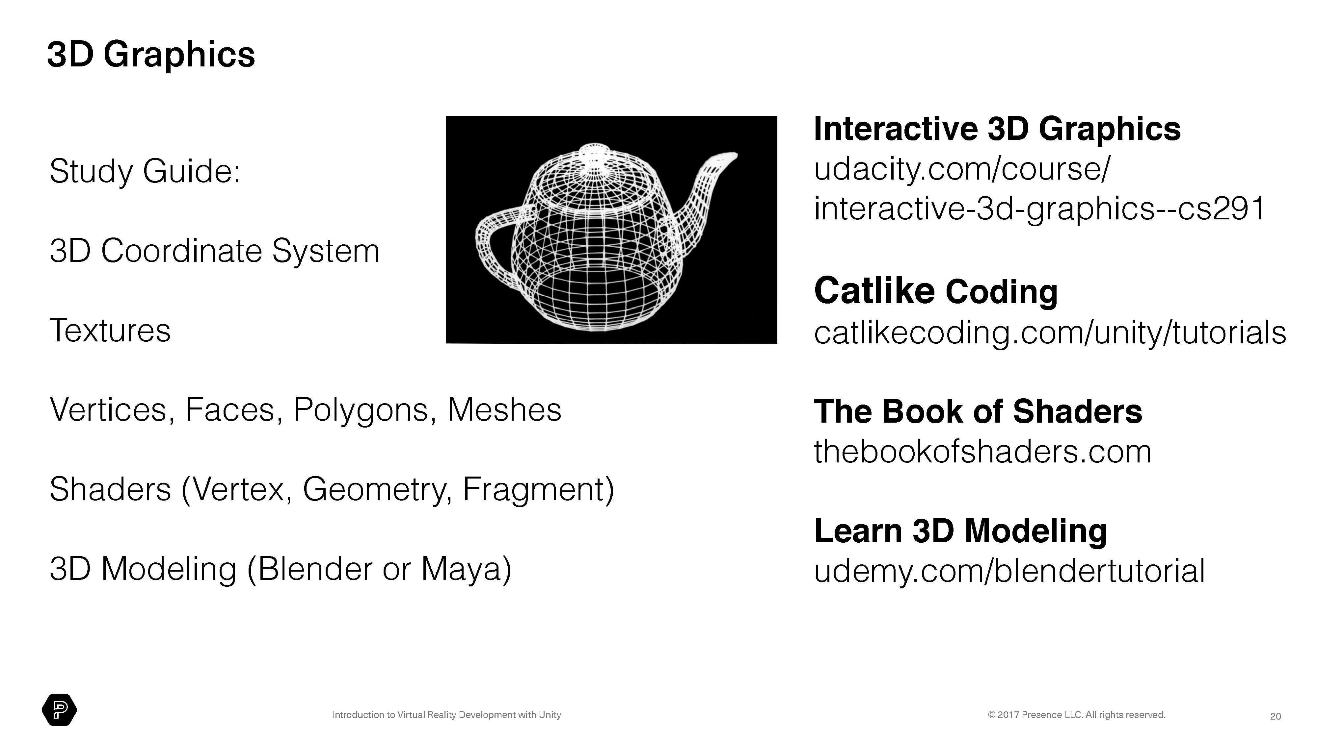

Slide 43
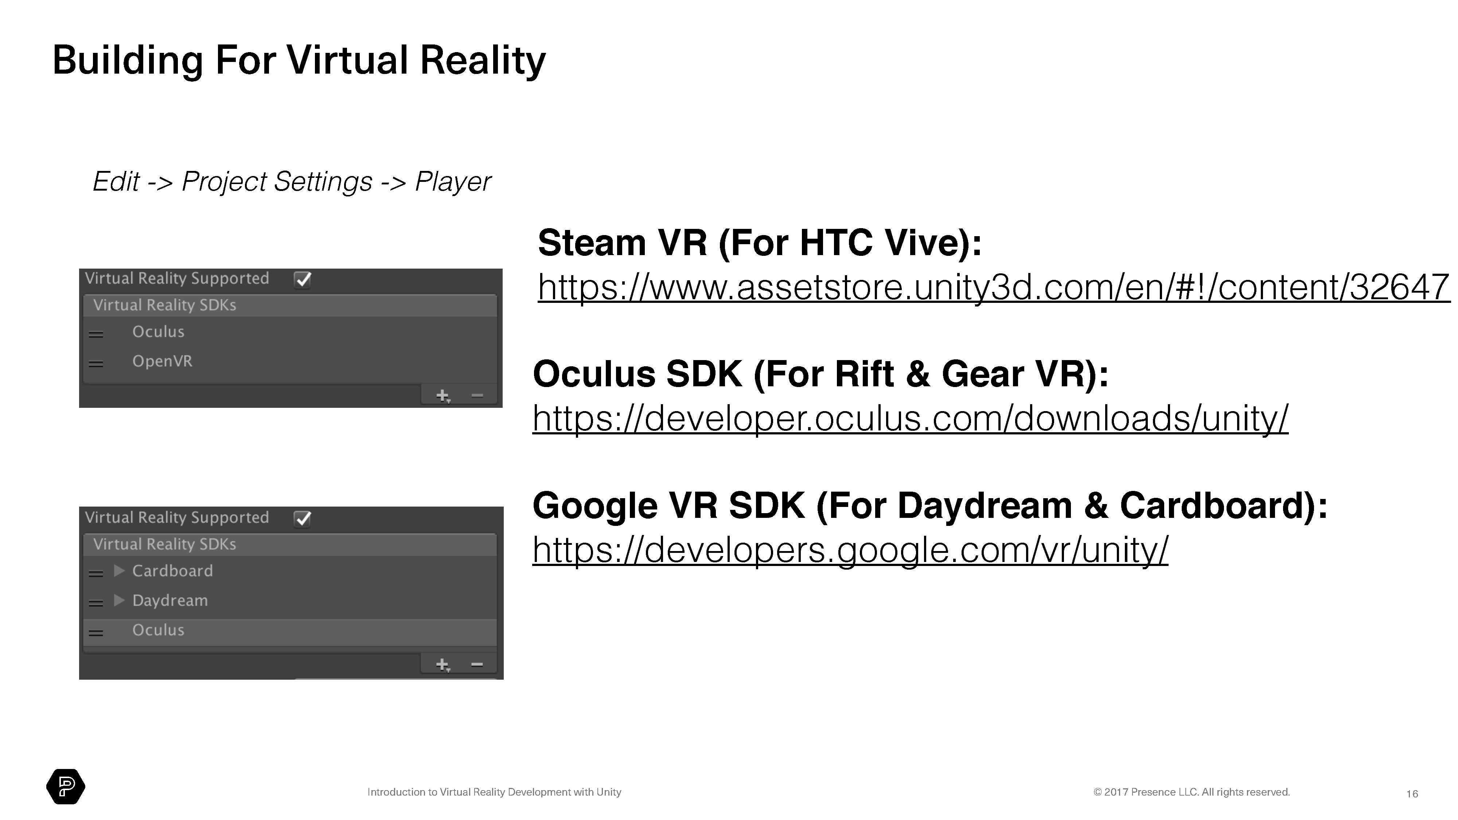

Slide 44


GITHUB -LINKEDIN

